Slide 1
Implementation of Yoga Pose Estimation and Feedback Mechanism using Pose Detection for Self Learning
Team Members Panel Number:16
Project Advisor: Dr. K Raghesh Krishnan / Asst. Professor(SG) / CSE
S.No | Reg.No | Name of the Student | Section
1 | CB.EN.U4CSE18112 | DHANUSH VARMA CH | CSE B
2 | CB.EN.U4CSE18162 | VENKAT R | CSE B
3 | CB.EN.U4CSE18174 | HARSHA VARDHAN D | CSE B
4 | CB.EN.U4CSE18511 | GUHAN K | CSE B

Slide 2
‹#›
Problem Statement
‹#›
To design a Machine Learning based application that monitors the yoga pose performed by the practitioner and gives real time feedback for improvement of the yoga posture.

Slide 3
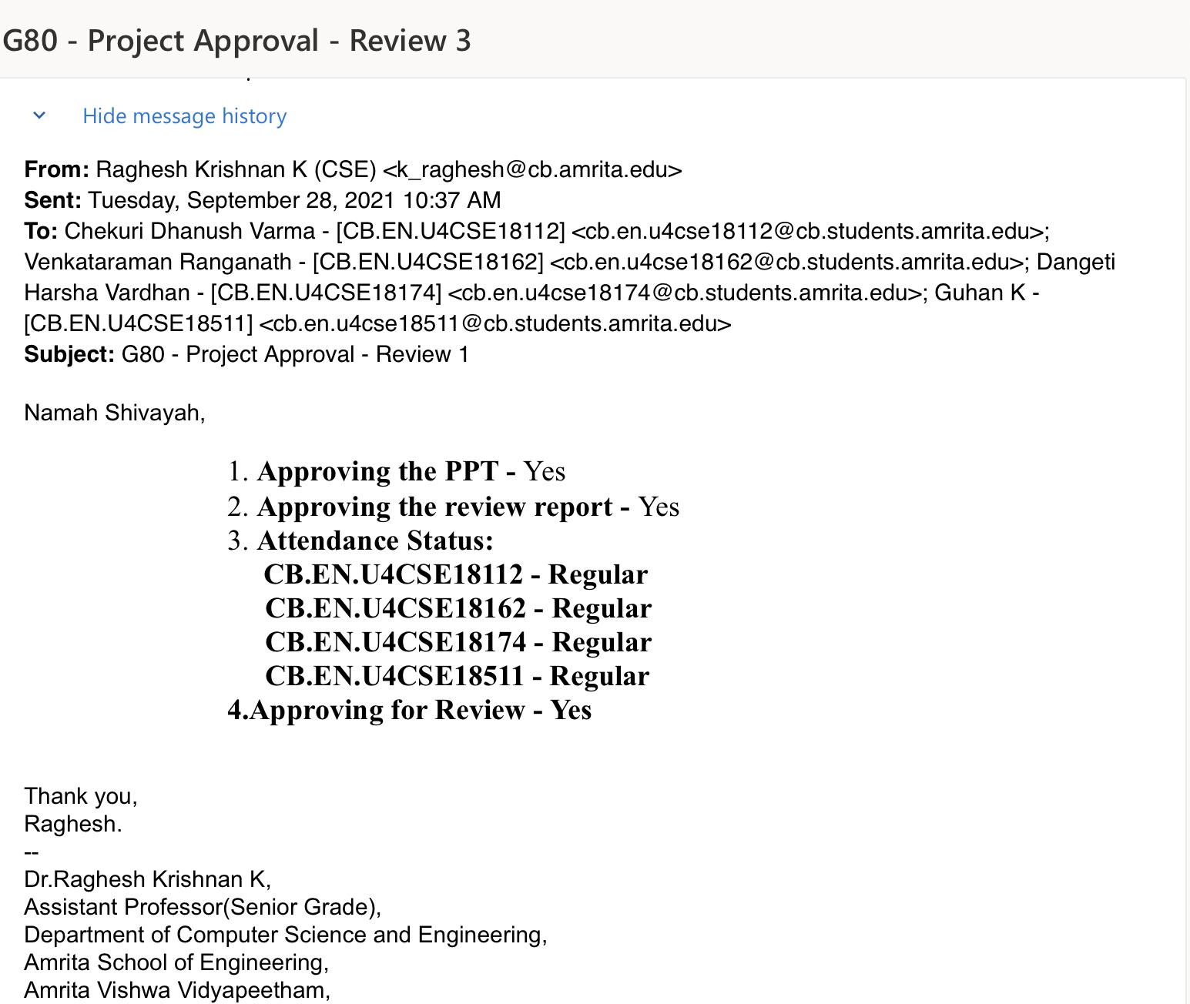
Guide Approval Mail

Slide 4
Review 2 Comments
‹#›
COMMENTS
Literature missed from the same department Should be able to preprocess images by removing background

Slide 5
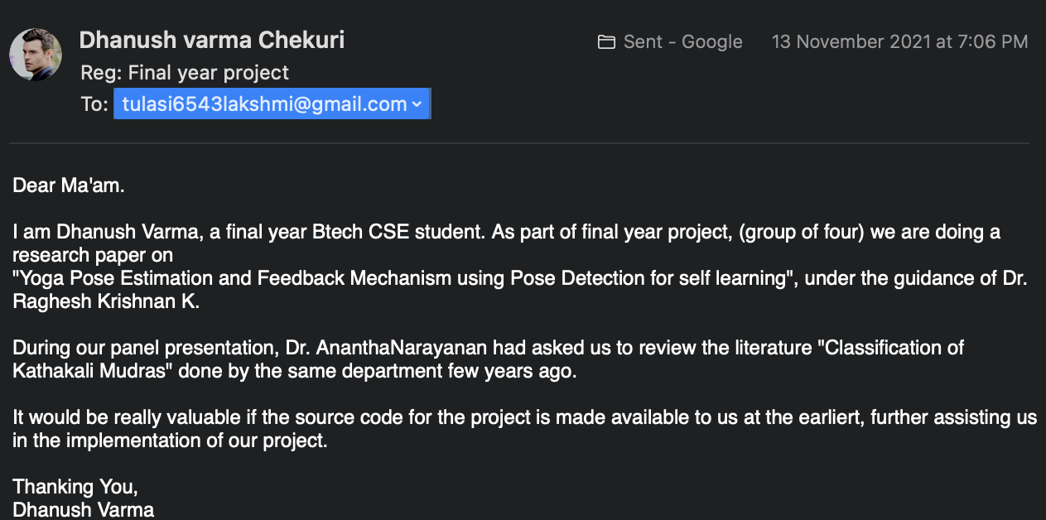
Actions Taken
‹#›
Literature Survey:
A dataset was made from scratch for Kathakali hand gestures, appropriate image processing techniques were applied and compared SVM with CNN for mudra classification.
Dataset: 684 images with a 70/30 split for train and test data
Features extracted from the image dataset given to SVM as input and an accuracy score of 40% was obtained.
Low accuracy obtained because of collision in feature extraction results.
CNN achieved an accuracy of 74%.
For the source code, we have contacted the authors of the paper.

Slide 6
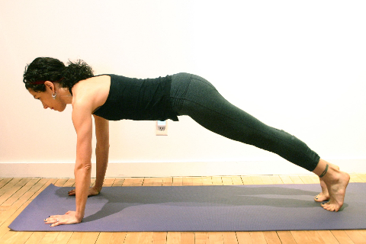
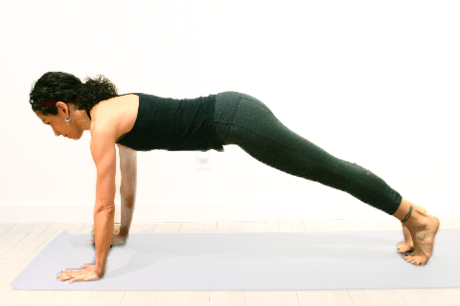
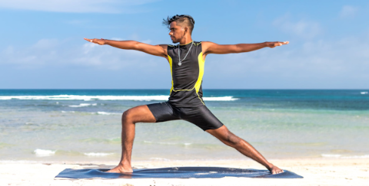
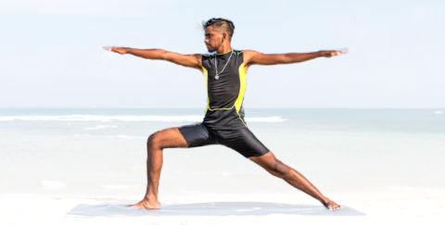
Actions Taken
‹#›
Background Segmentation:
We have used Mediapipe Pose to remove the background from the image.

Slide 7
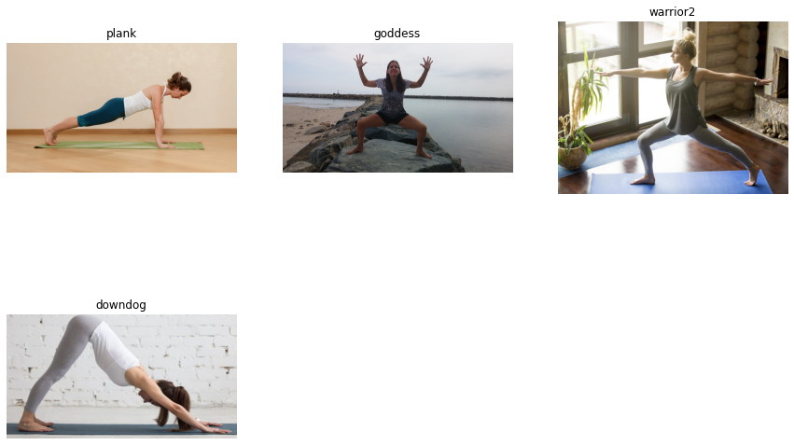
Dataset
7
The dataset has all the 4 most famous asanas namely downward dog, plank pose, tree pose, goddess pose and warrior-2 pose. This dataset contains over 1500 images.
Sample Output:

Slide 8
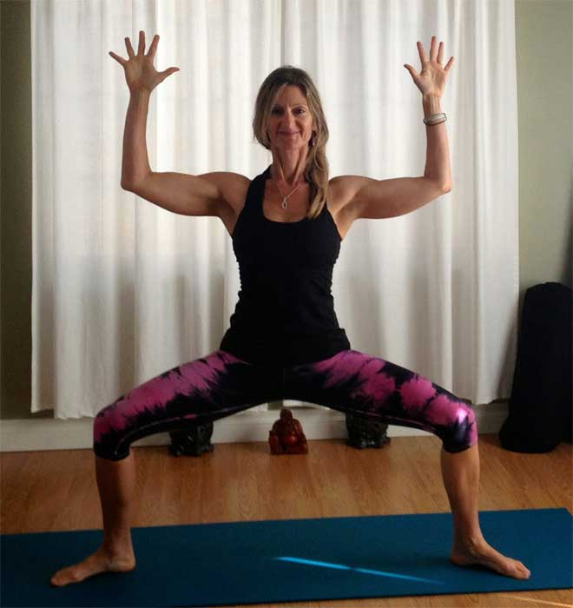
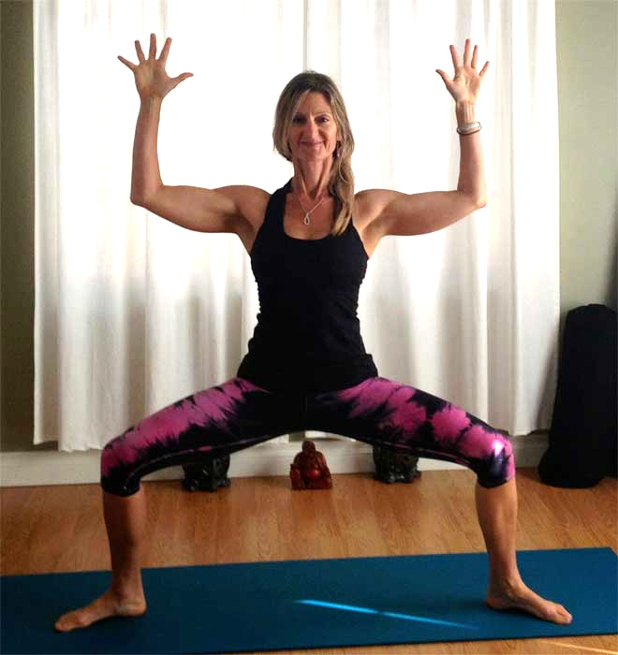
Preprocessing Techniques - Brightness
8
Images are first resized to reduce computation.
Brightness adjustment:
Gamma correction is a non-linear adjustment to individual pixel values. In image normalization, linear operations are carried out on individual pixels, gamma correction carries out a non-linear operation on the source image pixels, and can cause saturation of the image being altered.
Sample Output:

Slide 9
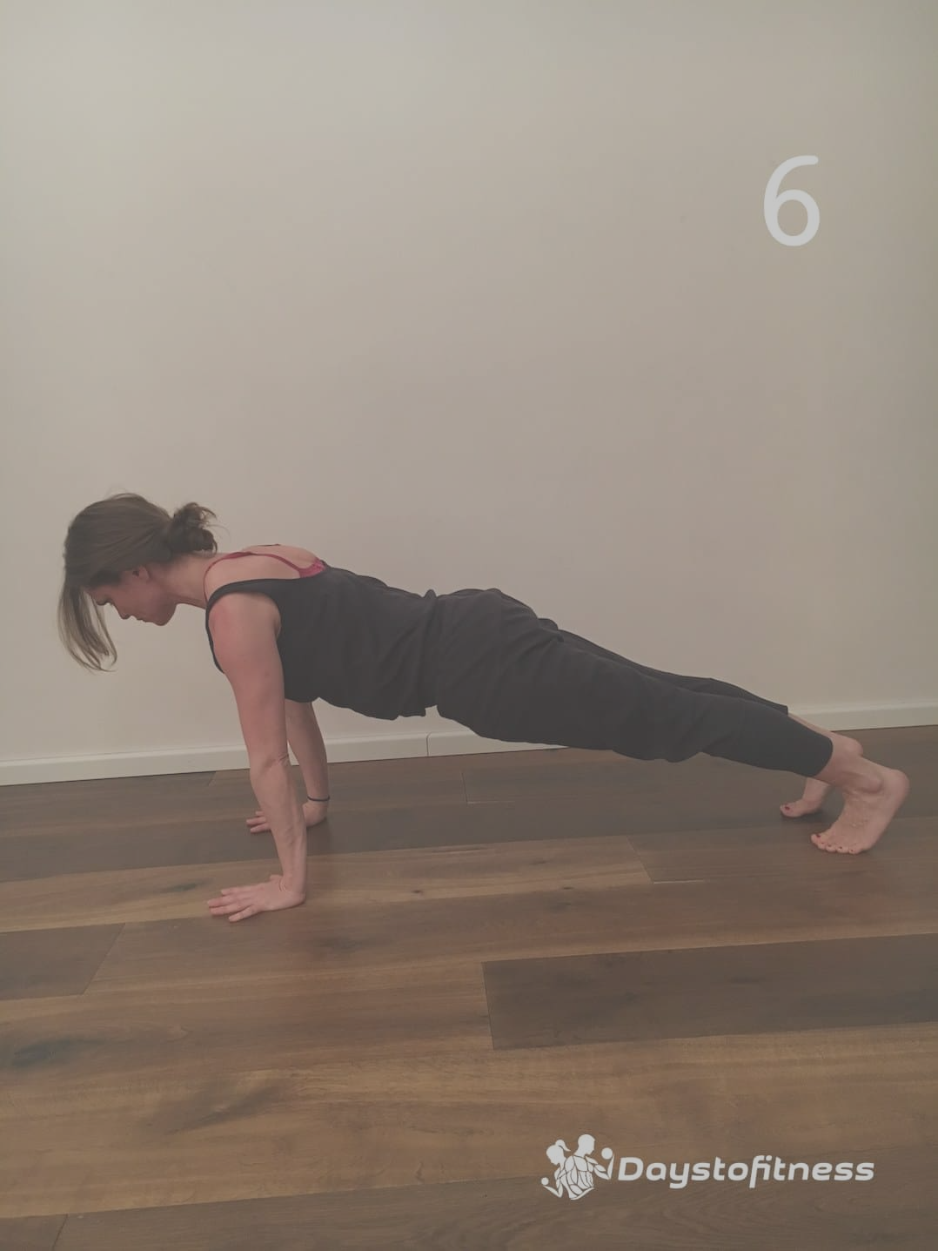
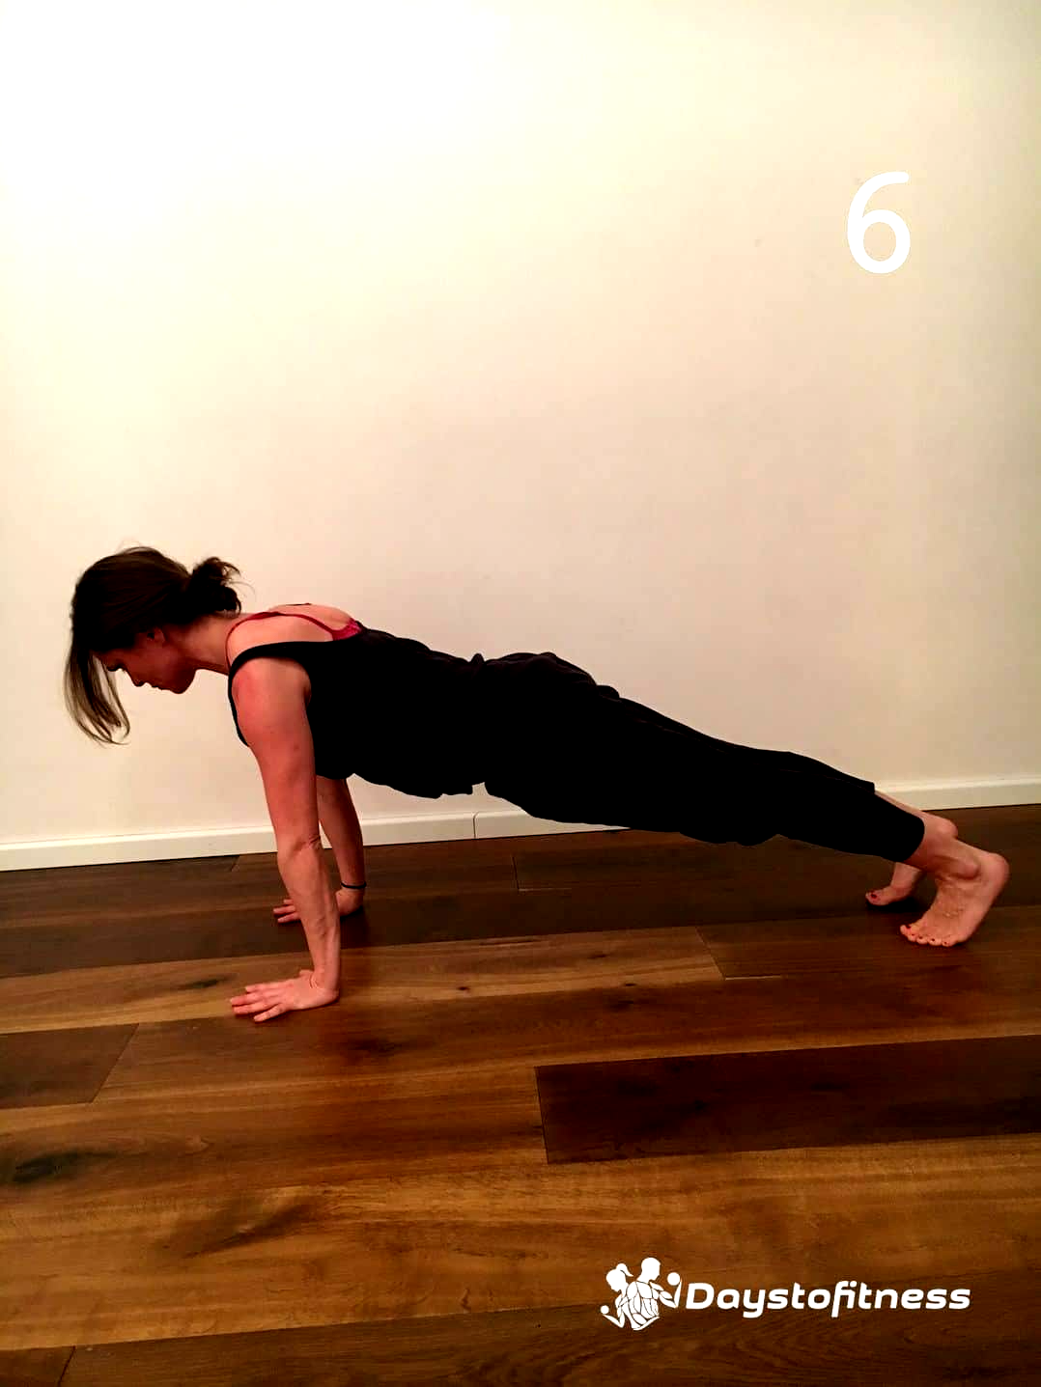
Preprocessing Techniques - Contrast
10
Contrast Adjustments:
Adjusts image contrast by its histogram.
To enhance contrast, spreads out intensity range of image.
This allows the image’s areas with lower contrast to gain a higher contrast.
Sample Output:

Slide 10
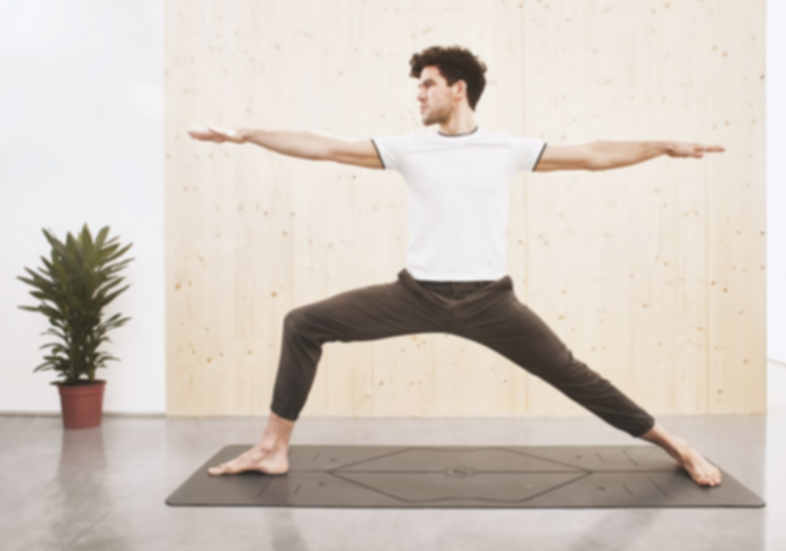

Preprocessing Techniques - Sharpening
9
Sharpening Images:
Edge detector used to compute the second derivatives of an image.
This determines if a change in adjacent pixel values is from an edge or continuous progression. Laplacian filter kernels usually contain negative values in a cross pattern, centered within the array. The corners are either zero or positive values. The center value can be either negative or positive.
Sample Output:

Slide 11
Body Segmentation
11
Media Pipe Segmentation function is used to blur the background of the image
The mask has the same width and height as the input image, and contains values in [0.0, 1.0] where 1.0 and 0.0 indicate “human” and “background” pixel respectively.
Sample Output:

Slide 12
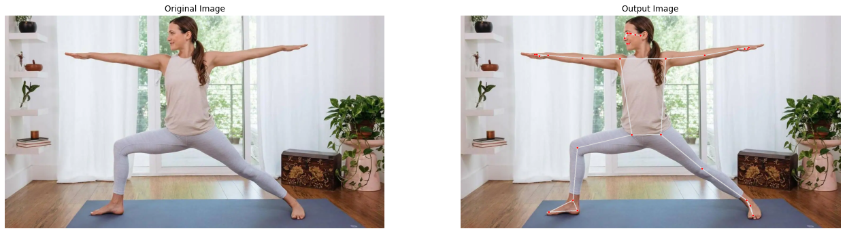
Pose Landmarks
12
Media pipe blaze pose is used to extract 3D coordinates of 33 joints from the image
x and y: Landmark coordinates normalized to [0.0, 1.0] by the image width and height respectively.
z: Represents the landmark depth with the depth at the midpoint of hips being the origin, and the smaller the value the closer the landmark is to the camera.
Sample Output:

Slide 13
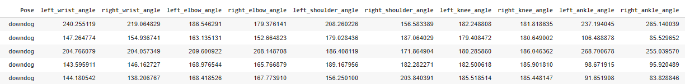
Angle Computation
13
[left_wrist_angle , right_wrist_angle , left_elbow_angle, right_elbow_angle , left_shoulder_angle, right_shoulder_angle, left_knee_angle, right_knee_angle, left_ankle_angle, right_ankle_angle, left_hip_angle, right_hip_angle]
Key angles at ( knee , elbow , shoulder , ankle ) are calculated from the points extracted and labelled with respective Asana name
Angle at a joint is given by:
angle = degrees(atan2(y3 - y2, x3 - x2) - math.atan2(y1 - y2, x1 - x2))
Sample Output:

Slide 14
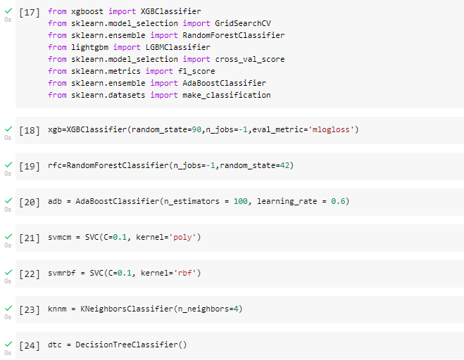
Results and Analysis
14
Finding the Best fit ML model:
Train and test machine learning algorithms (Random Forest, SVC, Decision Tree, KNN, Adaboost, RFC) using the data generated to find which model best fits.
Sample Output: Model Selection for the dataset

Slide 15
Results and Analysis
15
We have used two metrics of evaluation to evaluate the classifiers
The machine learning algorithms are trained, tested, metrics are evaluated and compared below:
Model | Accuracy Score | F1- Score
K Nearest Neighbours | 0.9943820224719101 | 0.9877977644256399
SVM - Poly Kernel | 0.9887640449438202 | 0.9838243875647213
XGBoost | 0.9831182901605438 | 0.9782318267339015
Decision Trees | 0.9831460674157303 | 0.9785827203906257
Random Forest | 0.9887640449438202 | 0.9877453004206302
Ada Boost | 0.8423618634886239 | 0.7874519073526639
From the table, we can say that K Nearest Neighbours is the BEST FIT ML MODEL for the dataset.

Slide 16
CONCLUSION
16
This work proposes a system for Yoga Pose Training and Feedback System to help the self-learning of Yoga for four different poses.
Various machine learning algorithms were studied and from the pose classification results, we find out that K-Nearest Neighbours provided the best results compared to other models with an accuracy of 99.4% and an F1 score of 98.7%. Therefore, it is important that the key body points are learnt, to compute the necessary angles.
In future work, we will extend the work to a much larger dataset with more than 4 asanas and interpret the Yoga Asana from a video stream instead of images, and hyper parameter tuning will be applied to the models to generate better accuracies.

Slide 17
References
17
Yash Agrawal, Yash Shah, Abhishek Sharma, "Implementation of Machine Learning Technique for Identification of Yoga Poses", Communication Systems and Network Technologies (CSNT) 2020 IEEE 9th International Conference on, pp. 40-43, 2020. https://ieeexplore.ieee.org/document/9115758
Maybel Chan Thar, Khine Zar Ne Winn, Nobuo Funabiki, "A Proposal of Yoga Pose Assessment Method Using Pose Detection for Self-Learning", Advanced Information Technologies (ICAIT) 2019 International Conference on, pp. 137-142, 2019. http://ieeexplore.ieee.org/document/8920892/
Muhammad Usama Islam, Hasan Mahmud, Faisal Bin Ashraf, Iqbal Hossain, Md. Kamrul Hasan, "Yoga posture recognition by detecting human joint points in real time using microsoft kinect", Humanitarian Technology Conference (R10-HTC) 2017 IEEE Region 10, pp. 668-673, 2017.
https://ieeexplore.ieee.org/document/8289047
Deepak Kumar, Anurag Sinha, ”Yoga Pose Detection and Classification Using Deep Learning” 2020 International Journal of Scientific Research in Computer Science Engineering and Information Technology https://ijsrcseit.com/CSEIT206623
T.-L. Le et al., "Human posture recognition using human skeleton provided by Kinect", Proc. International Conference on Computing Management and Telecommunications, 2013. https://ieeexplore.ieee.org/document/6482417
Sankara Narayanan, Devendra Kumar Misra , Kartik Arora and Harsh Rai, “Yoga Pose Detection Using Deep Learning Techniques” 2021 Social Science Research Network (SSRN) https://papers.ssrn.com/sol3/papers.cfm?abstract_id=384265
Guo, Y., Ma, L., Li, Z., Wang, X., & Wang, F. (2021). Monocular 3D multi-person pose estimation via predicting factorized correction factors. Computer Vision and Image Understanding, 213 doi:10.1016/j.cviu.2021.103278
Wang, Y. and Ye, J. (2021). “Tmf: Temporal motion and fusion for action recognition.”Computer Vision and Image Understanding, 103304.
Wheeler, B. J. and Karimi, H. A. (2021). “A semantically driven self-supervised algorithm for detecting anomalies in image sets.”Computer Vision and Image Understanding, 103279.
Bhavanam, Lakshmi Tulasi, and Ganesh Neelakanta Iyer. "On the classification of kathakali hand gestures using support vector machines and convolutional neural networks." 2020 International Conference on Artificial Intelligence and Signal Processing (AISP). IEEE, 2020.

Slide 18
THANK YOU

